Slide 1


Made with powerpoint

Slide 2
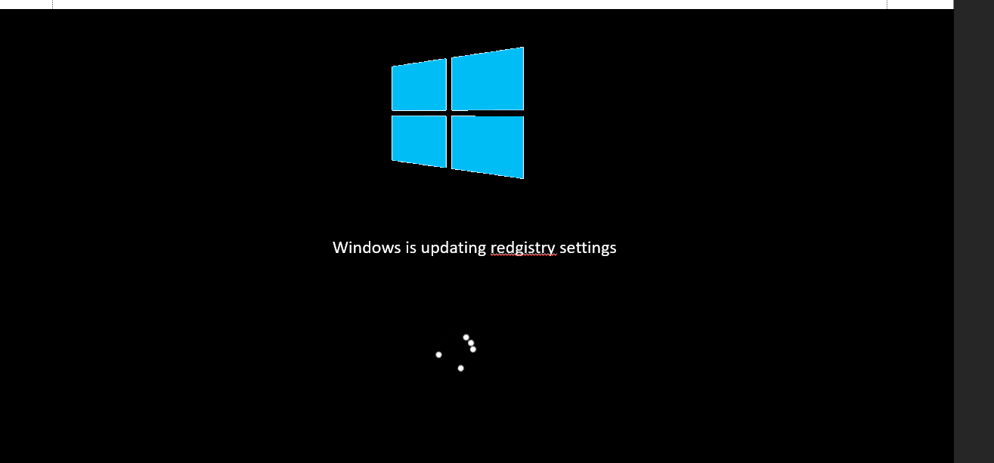


Slide 3
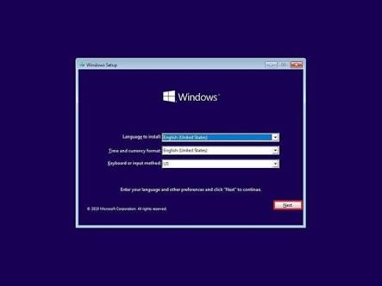
This Photo by Unknown Author is licensed under CC BY-SA-NC

Slide 4
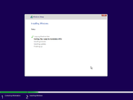
This Photo by Unknown Author is licensed under CC BY-SA

Slide 5


Windows is updating redgistry settings

Slide 6
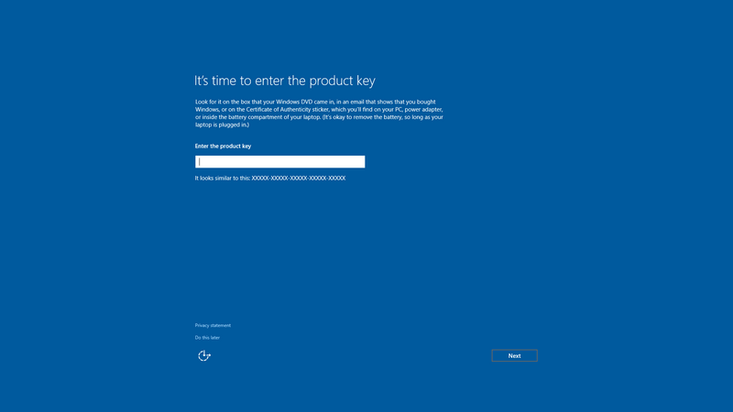
This Photo by Unknown Author is licensed under CC BY-SA

Slide 7
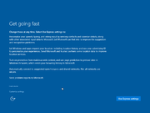
This Photo by Unknown Author is licensed under CC BY-SA

Slide 8
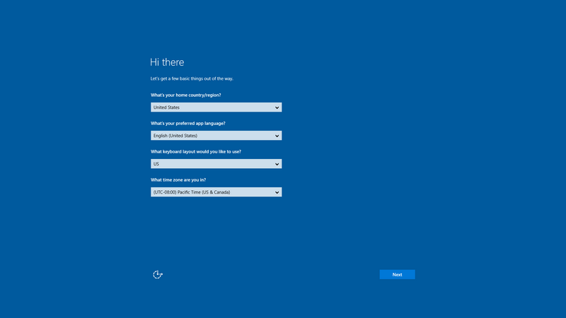
This Photo by Unknown Author is licensed under CC BY-SA

Slide 9
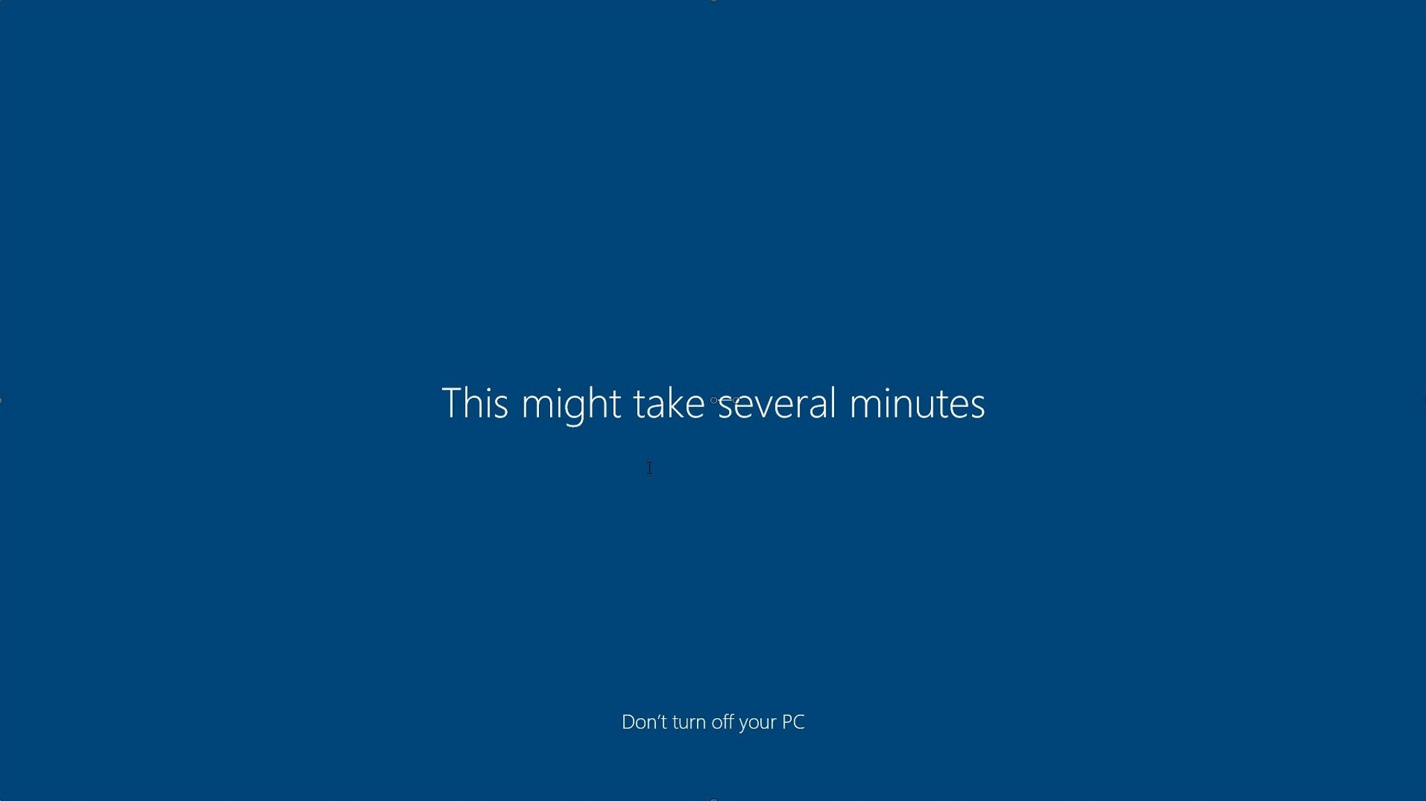

Slide 10
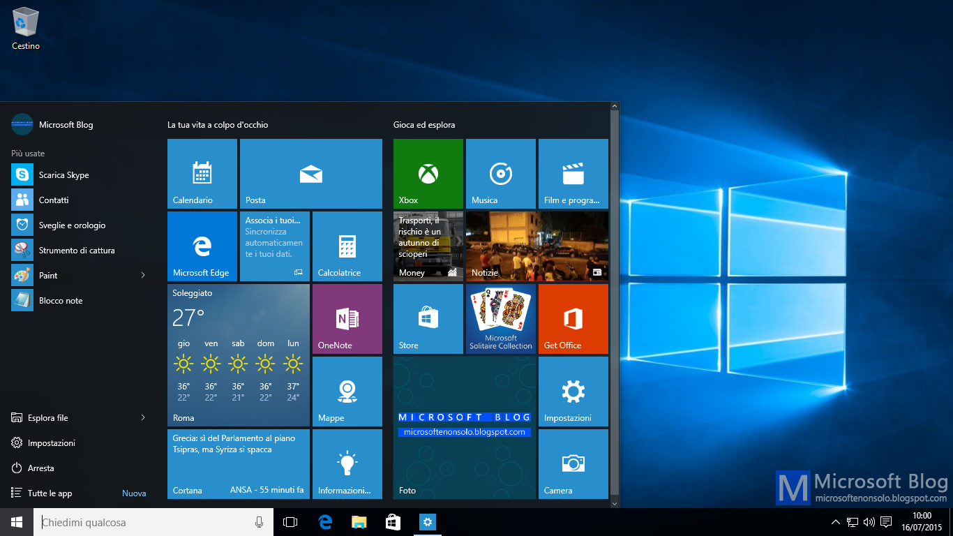
This Photo by Unknown Author is licensed under CC BY-NC

Slide 11
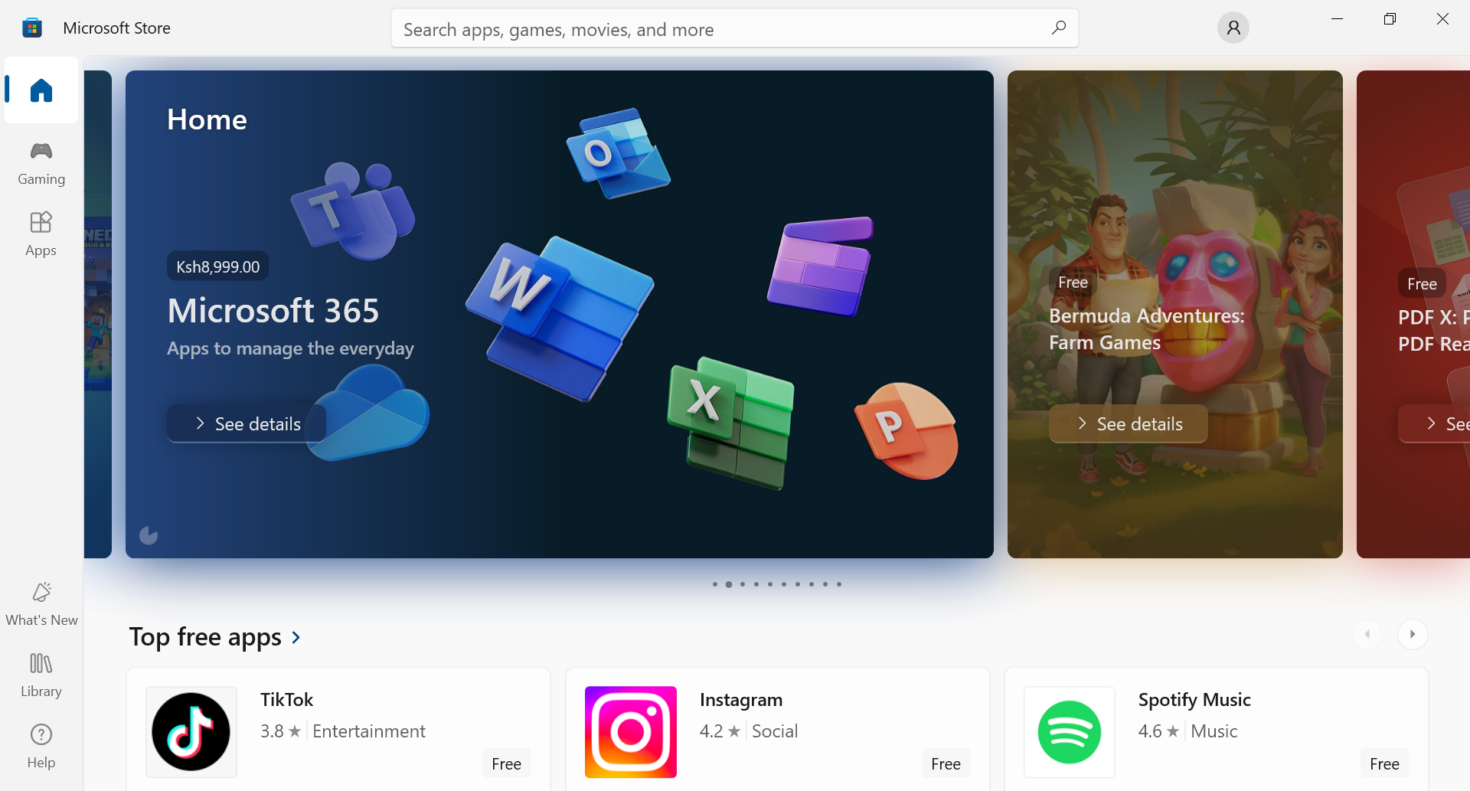

Slide 12
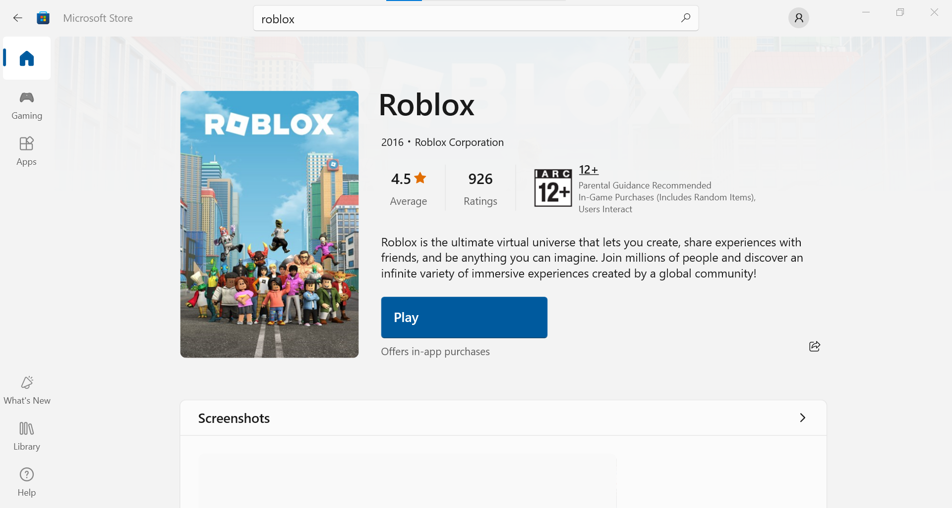

Slide 13
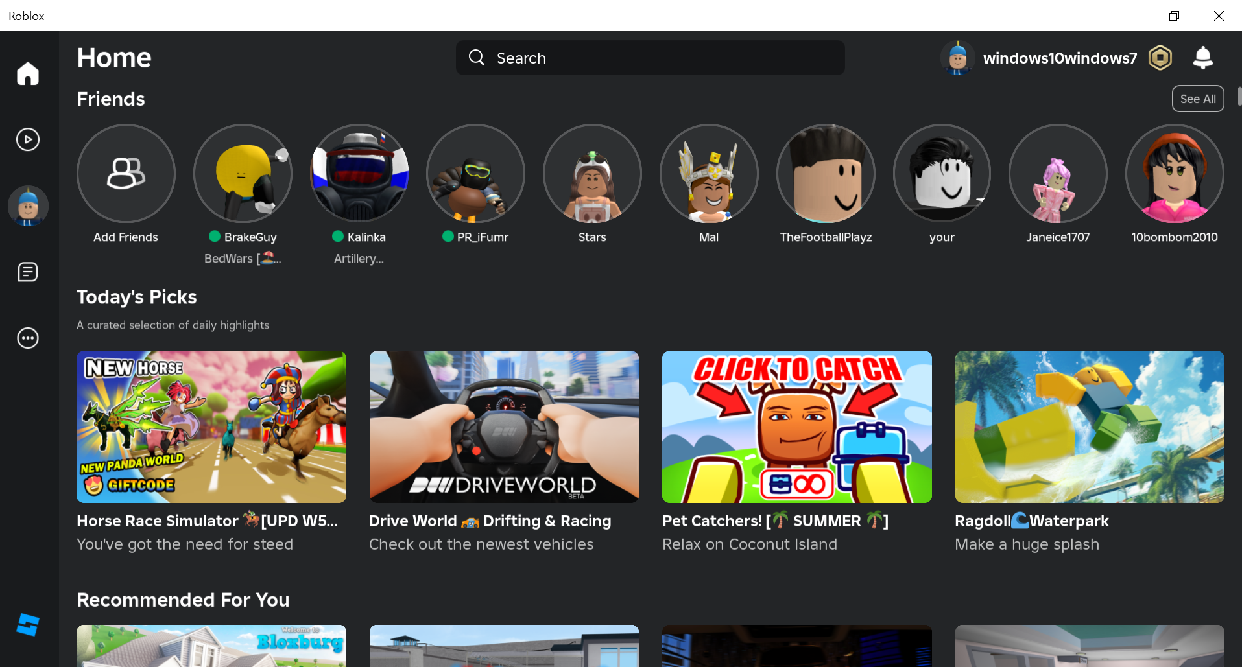

Slide 14
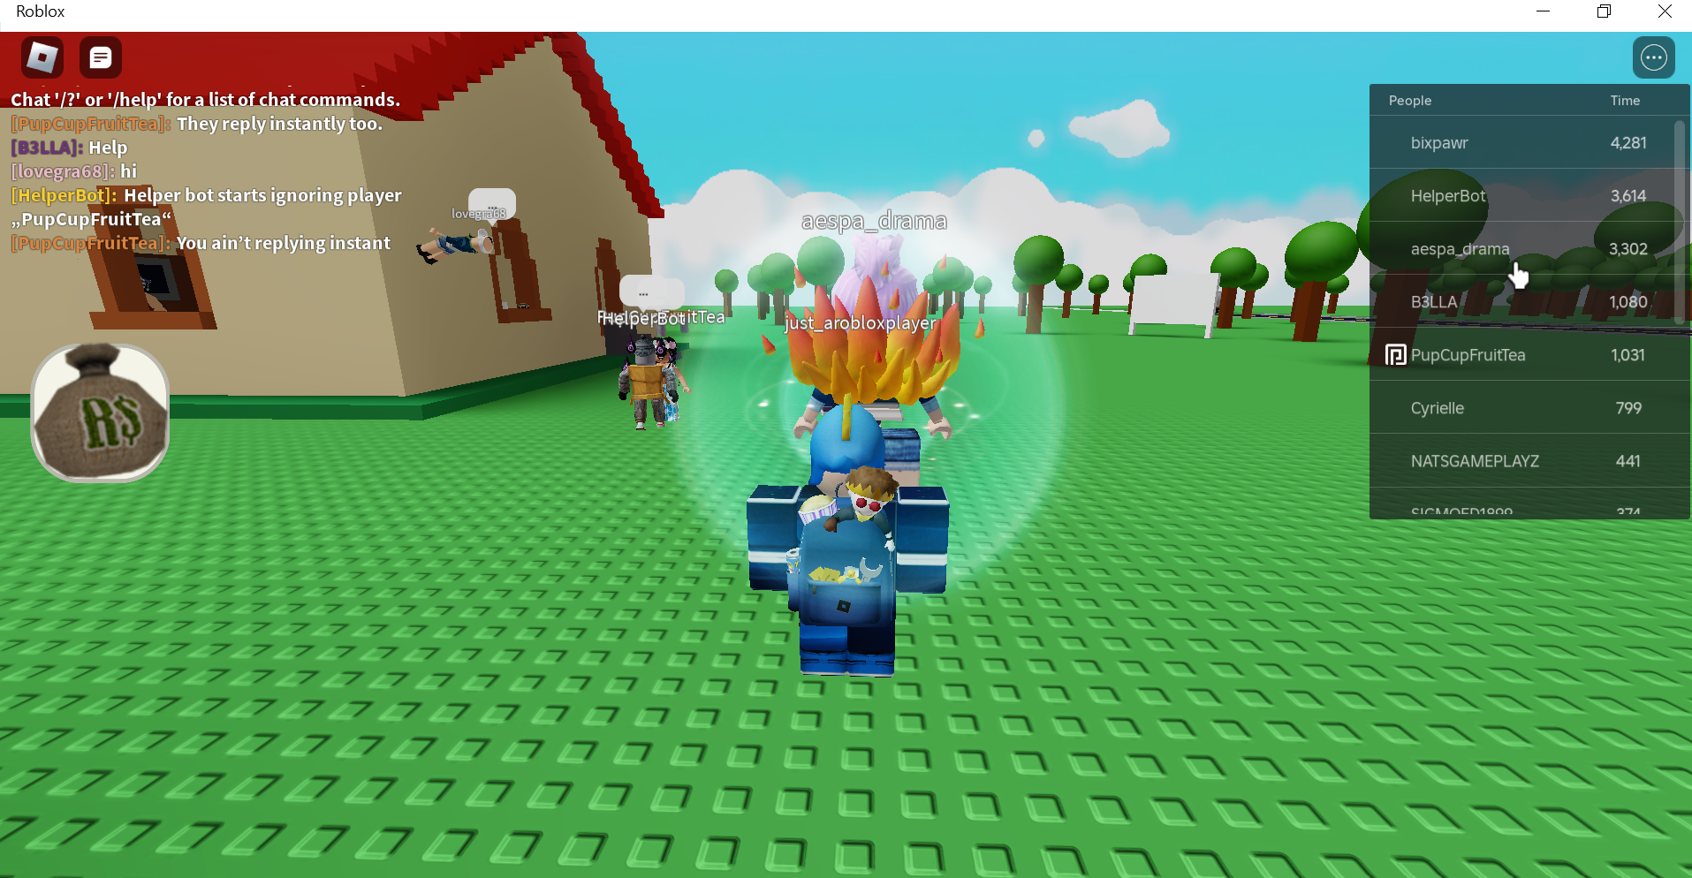

Slide 15
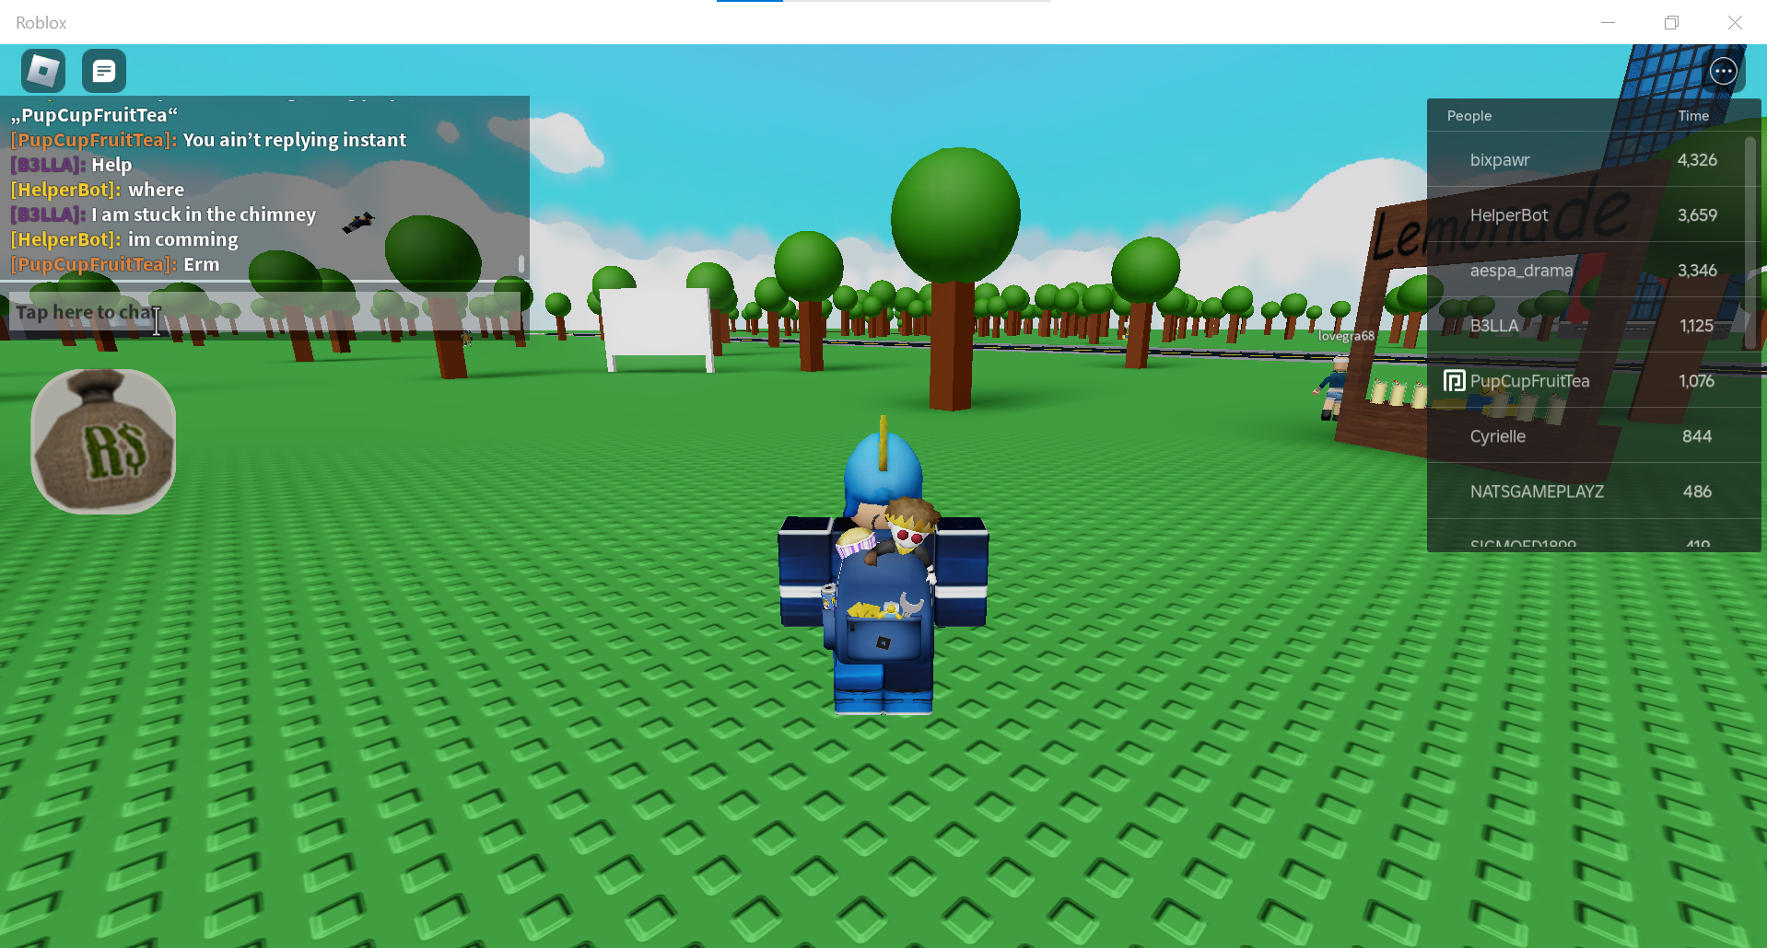

Slide 16
